Slide 1


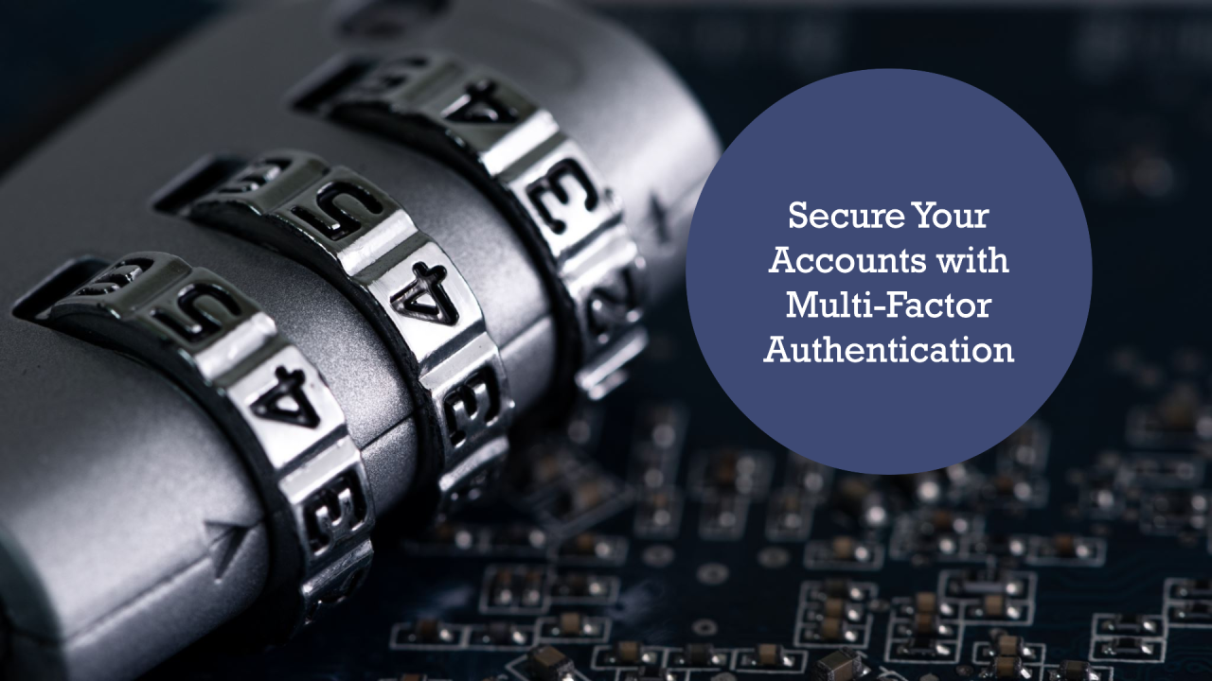
Session 3
Cyber Security - Multi-Factor Authentication (MFA)

Slide 2
Learning Outcomes
Understanding the concept of multi-factor authentication
Recognize and describe various forms of MFA, including SMS, app-based, hardware tokens, and biometrics
Evaluate the effectiveness of MFA in preventing unauthorized access and understand its advantages over traditional password-only systems.
What are the multi-factor authentication methods?
Outline best practices for implementing MFA

Slide 3
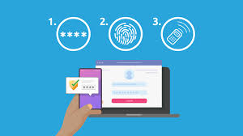
What is MFA (multi-factor authentication)?
Multi-factor authentication (MFA) is a multi-step account login process that requires users to enter more information than just a password. For example, along with the password, users might be asked to enter a code sent to their email, answer a secret question, or scan a fingerprint. A second form of authentication can help prevent unauthorized account access if a system password has been compromised.

Slide 4
Why is multi-factor authentication necessary?
Digital security is critical in today's world because both businesses and users store sensitive information online. Everyone interacts with applications, services, and data that are stored on the internet using online accounts. A breach, or misuse, of this online information could have serious real-world consequences, such as financial theft, business disruption, and loss of privacy.
While passwords protect digital assets, they are simply not enough. Expert cybercriminals try to actively find passwords. By discovering one password, access can potentially be gained to multiple accounts for which you might have reused the password. Multi-factor authentication acts as an additional layer of security to prevent unauthorized users from accessing these accounts, even when the password has been stolen. Businesses use multi-factor authentication to validate user identities and provide quick and convenient access to authorized users.

Slide 5
What are the benefits of multi-factor authentication?
Reduces security risk
Multi-factor authentication minimizes risks due to human error, misplaced passwords, and lost devices.
Enables digital initiatives
Organizations can undertake digital initiatives with confidence. Businesses use multi-factor authentication to help protect organizational and user data so that they can carry out online interactions and transactions securely.
Improves security response
Companies can configure a multi-factor authentication system to actively send an alert whenever it detects suspicious login attempts. This helps both companies and individuals to respond faster to cyberattacks, which minimizes any potential damage.

Slide 6
MFA Examples
There are many different methods for verification within the four categories above, but here are the most common methods that the average user will encounter in their digital life.
1. Time-Based One-Time Password (TOTP)
A TOTP is a code, usually a 6-digit number, that is only valid for a short period of time – often thirty to sixty seconds. With this method, the user can use a password manager that stores TOTP codes or download an authenticator app to store and access these codes. After entering their password to log in to an account, the user will be prompted to enter the code to verify their identity.
This is one of the most secure forms of MFA because the codes are protected and difficult to intercept. The only way a cybercriminal can steal the code is by compromising the device on which the code is generated, by stealing it or infecting it with malware.

Slide 7
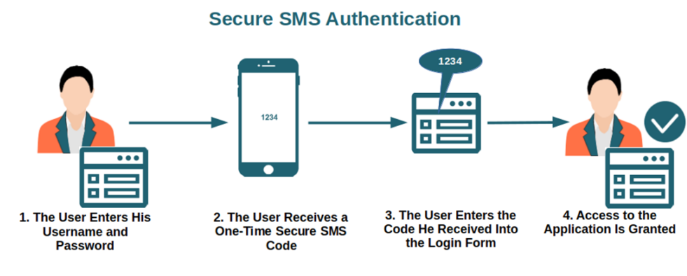
2. SMS text message token
This method requires the user to enter their phone number when they create an account. When the user logs in with their credentials, they will be asked to enter a code sent by SMS text to their phone. With the code, they can then log in. This is one of the less secure methods of MFA because phone numbers for individuals are usually easy to find online. If a cybercriminal has the user’s phone number, they can use a technique called SIM swapping to intercept their SMS texts.
The advantage is that it’s a convenient method and doesn’t require the user to download a new app. Some accounts offer SMS text tokens as the only MFA method. It’s better than no MFA at all, so if it’s the only option you should still use it.

Slide 8
3. Email token
Email tokens are similar to SMS tokens, but they use your email address to deliver the code. Similarly, the risk of email tokens is that a cybercriminal could hack your email account in order to get access to the code. If you use this method, be sure to secure your email account with a unique, complex password in order to protect it.
4. Hardware security key
A hardware security key is a physical token. After connecting it to your accounts, you should keep it in a secure location where you won’t lose it. When you log in to your account, you will usually insert the key into a USB port or tap it on your device. Your device will sense the key and validate your identity. This is one of the most secure methods of authentication because it’s impossible for a cybercriminal to steal it over the internet. The only way this method could be compromised is if the physical key was stolen.

Slide 9

5. Biometric authentication
Biometric authentication validates your identity via facial recognition, fingerprint scan or iris scan. When first setting up biometric authentication, the user will register their fingerprint or facial scan with the device. Then the system will compare future scans to the first one to verify your identity.
Because everyone has a unique fingerprint and face, this can be quite secure. Fingerprints and facial recognition are already used widely on personal devices for login identification. It’s also often used as an MFA method for apps, commonly for banking or other apps with sensitive data. Biometrics are usually stored locally on the device to protect them.

Slide 10
Effectiveness of Multi-Factor Authentication (MFA) in Preventing Unauthorized Access
1. Enhanced Security: MFA significantly increases security by requiring multiple forms of verification. Even if a password is compromised, an attacker would still need the second factor (like a one-time code or a biometric scan) to gain access. This makes unauthorized access considerably more difficult.
2. Reduction in Phishing Risks: MFA mitigates the risks associated with phishing attacks. Even if users unknowingly provide their passwords to a malicious actor, the presence of an additional authentication factor can prevent unauthorized access. For example, a code sent to a user’s phone can act as a barrier even if the password is stolen.

Slide 11
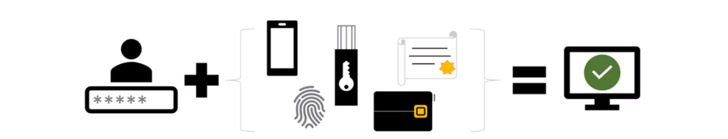
Effectiveness of Multi-Factor Authentication (MFA) in Preventing Unauthorized Access
3. Protection Against Credential Stuffing: Credential stuffing attacks, where attackers use stolen username and password combinations to access accounts, are less effective against accounts secured with MFA. Since MFA requires a second factor, it can thwart these attacks, reducing the likelihood of unauthorized access.
4. Increased User Awareness: The implementation of MFA often raises user awareness about security practices. Knowing that their accounts are protected by multiple factors encourages users to choose stronger passwords and remain vigilant against potential security threats.

Slide 12
Advantages Over Traditional Password-Only System
1. Improved Risk Management: While password-only systems can be vulnerable to brute force attacks and social engineering, MFA adds an additional layer that complicates these attacks, allowing organizations to better manage their security risks.
2. Compliance with Regulations: Many regulatory frameworks and industry standards now require MFA for sensitive data access (e.g., PCI DSS, GDPR). Organizations that implement MFA not only enhance security but also ensure compliance with these regulations.
3. User Trust and Confidence: By utilizing MFA, organizations can instill greater trust and confidence among users regarding their data security. Users are more likely to engage with services that demonstrate a commitment to protecting their information.

Slide 13
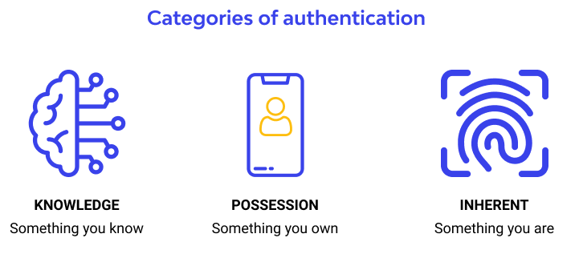
What are the multi-factor authentication methods?
MFA authentication methods are based on something you know, something you have and/or something you are. We describe some common authentication factors below:
Knowledge factor
In the knowledge factor method, users have to prove their identity by revealing information no one else knows. A typical example of this authentication factor is secret questions with answers only the user would know, such as the name of their first pet or their mother's maiden name. Applications may also request access to a four-digit pin code.

Slide 14
What are the multi-factor authentication methods?
Possession factor
In the possession factor method, users identify themselves by something they uniquely own. Here are some examples:
Physical devices like mobile phones, security tokens,display cards, hardware fobs, and security keys.
Digital assets like email accounts and authenticator applications
The system sends a secret code as a digital message to these devices or assets, which the user then re-enters into the system. The account can be compromised if the device is lost or stolen. Some security tokens circumvent this problem by connecting directly to the system so that they cannot be digitally accessed.

Slide 15
What are the multi-factor authentication methods?
Inherence factor
Inherence methods use information that is inherent to the user. These are a few examples of such authentication factors:
Fingerprint scans
Retina scans
Voice recognition
Facial recognition
Behavioral biometrics like keystroke dynamics
The application has to collect and store this information along with the password during registration. The business managing the application has to protect biometrics along with passwords.

Slide 16
What are the best practices for setting up multi-factor authentication?
All businesses should set up enterprise-wide policies to restrict access and secure digital resources. The following are some of the best practices in access management:
Create user roles
You can fine-tune access control policies by grouping users into roles. For example, you can grant privileged admin users more access rights than end-users.
Create strong password policies
You should still enforce strong policies even if you have three or four-factor authentication. You can implement rules to create passwords with a combination of upper and lower case, special characters, and numbers.
Rotate security credentials
It is an excellent practice to ask your users to change passwords regularly. You can automate this process by having the system deny access until the password has been changed.

Slide 17
PYTHON PRACTICAL ACTIVITY ( Code Link )
Practical Activity # 1 (MFA Simulation – Password + OTP)
Practical Activity # 2 (TOTP Timer-Based Simulation)
Practical Activity # 3 (Biometric Fingerprint Mock)
Practical Activity # 4 (SMS-Based MFA Simulation)
Practical Activity # 5 (MFA Policy Validator – Best Practices Checker)

Slide 18
Practical Activity # 1 (MFA Simulation – Password + OTP)
🔐 Demonstrates two-factor authentication using a password and a one-time password (OTP).
import random
def generate_otp():
return str(random.randint(100000, 999999))
print("🔐 Multi-Factor Authentication (MFA) Demo")
username = input("Enter username: ")
password = input("Enter password: ")
if username == "student" and password == "MFAstrong!2024":
otp = generate_otp()
print(f"📲 Your OTP is: {otp} (simulated)")
user_otp = input("Enter the OTP: ")
if user_otp == otp:
print("✅ MFA success! Access granted.")
else:
print("❌ Incorrect OTP.")
else:
print("❌ Username or password incorrect.")

Slide 19
Practical Activity # 2 (TOTP Timer-Based Simulation)
⏱️ Emulates time-sensitive one-time password verification (like Google Authenticator).
import time
import hashlib
def generate_totp(secret, interval=30):
counter = int(time.time()) // interval
return hashlib.sha1(f"{secret}{counter}".encode()).hexdigest()[:6]
shared_secret = "SecretKey123"
print("⏳ TOTP Generator (Time-based OTP)")
otp = generate_totp(shared_secret)
print(f"Your current OTP is: {otp}")
input("Enter the OTP shown: ")
print("✅ Verification Passed (Simulated)")

Slide 20
Practical Activity # 3 (Biometric Fingerprint Mock)
🧬 Simulates inherence factor by matching stored biometric data.
stored_fingerprints = {
"student1": "A1B2C3D4",
"admin": "F5G6H7I8"
}
print("🧬 Biometric Authentication (Fingerprint) Simulator")
user = input("Username: ")
scan = input("Enter fingerprint hash (simulate): ")
if stored_fingerprints.get(user) == scan:
print("✅ Fingerprint match! Identity confirmed.")
else:
print("❌ Authentication failed. Fingerprint does not match.")

Slide 21
Practical Activity # 4 (SMS-Based MFA Simulation)
📱 Mimics sending a text message token to verify access.
import random
print("📲 SMS-Based Authentication")
phone_number = input("Enter your phone number: ")
print("Sending token...")
sms_code = str(random.randint(100000, 999999))
print(f"Simulated SMS Code: {sms_code}")
entered_code = input("Enter the code you received: ")
if entered_code == sms_code:
print("✅ Access granted via SMS token.")
else:
print("❌ Incorrect code.")

Slide 22
Practical Activity # 5 (MFA Policy Validator – Best Practices Checker)
🔐 Helps students assess their use of MFA and password security in daily life.
print("🔒 MFA Policy & Security Check")
mfa_enabled = input("Do you use MFA on your main email account? (yes/no): ").strip().lower()
strong_pass = input("Is your password at least 12 characters and includes symbols? (yes/no): ").strip().lower()
backup = input("Do you have a backup method like security questions or a hardware key? (yes/no): ").strip().lower()
score = sum([mfa_enabled == "yes", strong_pass == "yes", backup == "yes"])
if score == 3:
print("✅ Great! You're well protected with strong MFA practices.")
elif score == 2:
print("⚠️ Not bad, but there’s room for improvement.")
else:
print("❌ Your account is at risk! Please update your security settings.")

Slide 23


Exercise
1. What is the primary benefit of using multi-factor authentication (MFA)? A) It makes passwords unnecessary B) It increases login speed for users C) It adds a second layer of security to prevent unauthorized access D) It allows users to store their passwords in browsers Answer: C
2. Which of the following is an example of the “possession factor” in MFA? A) Security question answer B) Facial recognition C) Hardware security key D) Password Answer: C

Slide 24
Exercise
3. Why is SMS-based MFA considered less secure than other methods? A) It requires a Wi-Fi connection B) Users often forget the code C) It can be bypassed using CAPTCHA D) Phone numbers can be hijacked using SIM swapping Answer: D
4. What makes biometric authentication effective in a multi-factor system? A) It relies on complex passwords B) It doesn’t require any initial setup C) It uses a unique physical trait of the user D) It is stored on remote servers for faster access Answer: C
5. Which of the following is a best practice when implementing MFA? A) Disable password rules since MFA is secure B) Use shared login credentials across departments C) Rotate security credentials and enforce strong password policies D) Allow users to opt-out of MFA Answer: C

Slide 25
Quiz
Now it’s your turn to apply what you’ve learned! Click the link below to take an interactive quiz in the Streamlit app. This quiz will test your knowledge on Multifactor Authentication (MFA) and its role in Information Security.
How to Approach the Quiz:
Understand MFA: Make sure you understand how Multifactor Authentication (MFA) enhances security by requiring two or more verification factors (such as a password, a fingerprint, or a code sent to your phone).
Choose Your Answers Carefully: Think about how MFA works in real-life scenarios and how it protects against unauthorized access to sensitive data.
Test Your Knowledge: The quiz will help you evaluate how well you grasp the importance of MFA in protecting your information and systems.
Click Here to begin the quiz! https://mfa-cybersecurity.streamlit.app/

